Slide 1
Хранение данных
Куликов Никита

Slide 2
Напоминание отметиться на портале

Slide 3
Сеть
Хранилище
Содержание занятия

Slide 4
OkHttp
Retrofit
Сеть

Slide 5
OkHttp
OkHttpClient client = new OkHttpClient(); public String loadByUrl(String url) throws IOException { Request request = new Request.Builder() .url(url) .build(); try (Response response = client.newCall(request).execute()) { return response.body().string(); } }

Slide 6
Моки

Slide 7
Просто строка
public String loadByUrl(String url) throws IOException { return “My str” }

Slide 8
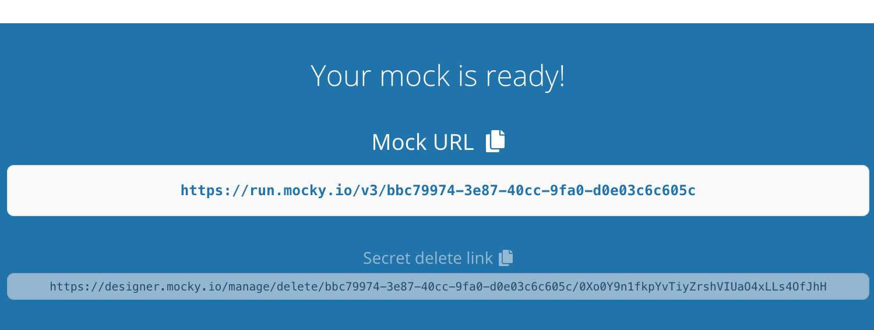
designer.mocky.io

Slide 9
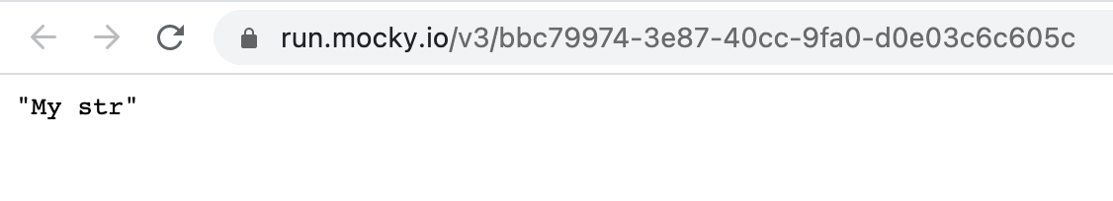
designer.mocky.io

Slide 10
Retrofit

Slide 11
Как пользоваться?
public interface GitHubService { @GET("users/{user}/repos") Call<List<String>> listRepos(@Path("user") String user); }
public void load() throws IOException { Retrofit retrofit = new Retrofit.Builder() .baseUrl("https://api.github.com/") .build(); GitHubService service = retrofit.create(GitHubService.class); service.listRepos("lionzxy").execute(); }

Slide 12
Почитаем javadoc
/** * Synchronously send the request and return its response. * * @throws IOException if a problem occurred talking to the server. * @throws RuntimeException (and subclasses) if an unexpected error occurs creating the request * or decoding the response. */ Response<T> execute() throws IOException;

Slide 13
Async call
service.listRepos("lionzxy").enqueue(new Callback<List<String>>() { @Override public void onResponse(Call<List<String>> call, retrofit2.Response<List<String>> response) { } @Override public void onFailure(Call<List<String>> call, Throwable t) { } });

Slide 14
Storage

Slide 15
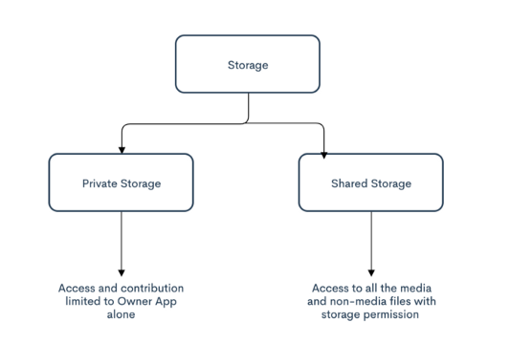
Хранилище в Android

Slide 16
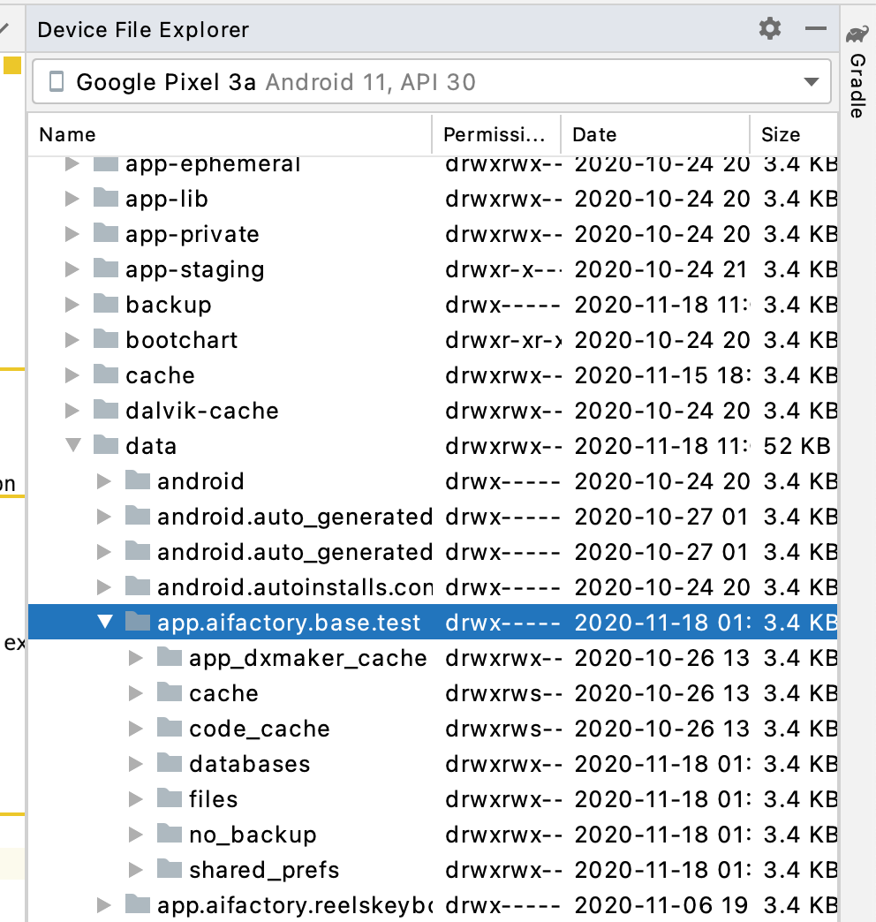
Internal storage
getCacheDir()
getDir()
getDatabasePath()
getFilesDir()
openFileInput()
openFileOutput()
/data/data/packagename/

Slide 17
Internal storage
getCacheDir()
getDir()
getDatabasePath()
getFilesDir()
openFileInput()
openFileOutput()

Slide 18
SharedPreference
public static final String PREFS_NAME = "MyPrefsFile"; public void readPref() { SharedPreferences settings = getSharedPreferences(PREFS_NAME, 0); boolean silent = settings.getBoolean("silentMode", false); }
public void writePref() { SharedPreferences settings = getSharedPreferences(PREFS_NAME, 0); SharedPreferences.Editor editor = settings.edit(); editor.putBoolean("silentMode", mSilentMode); editor.apply(); }

Slide 19
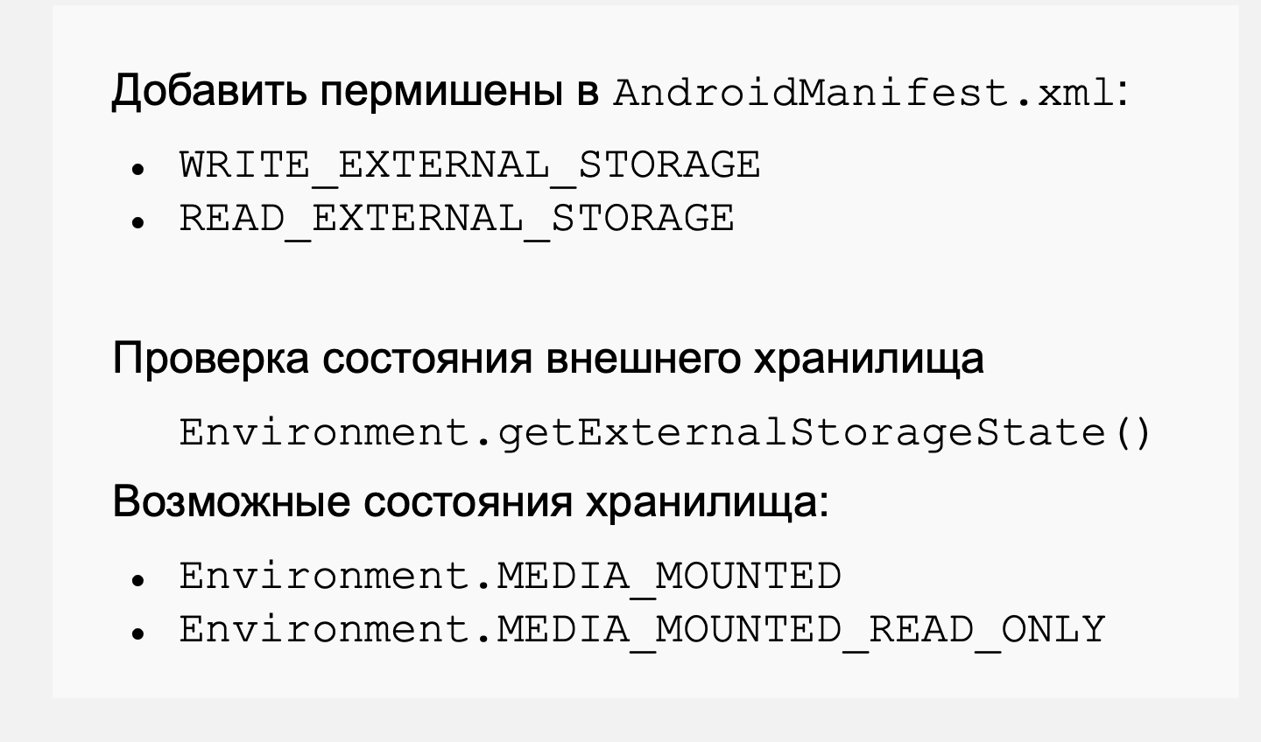
External storage

Slide 20
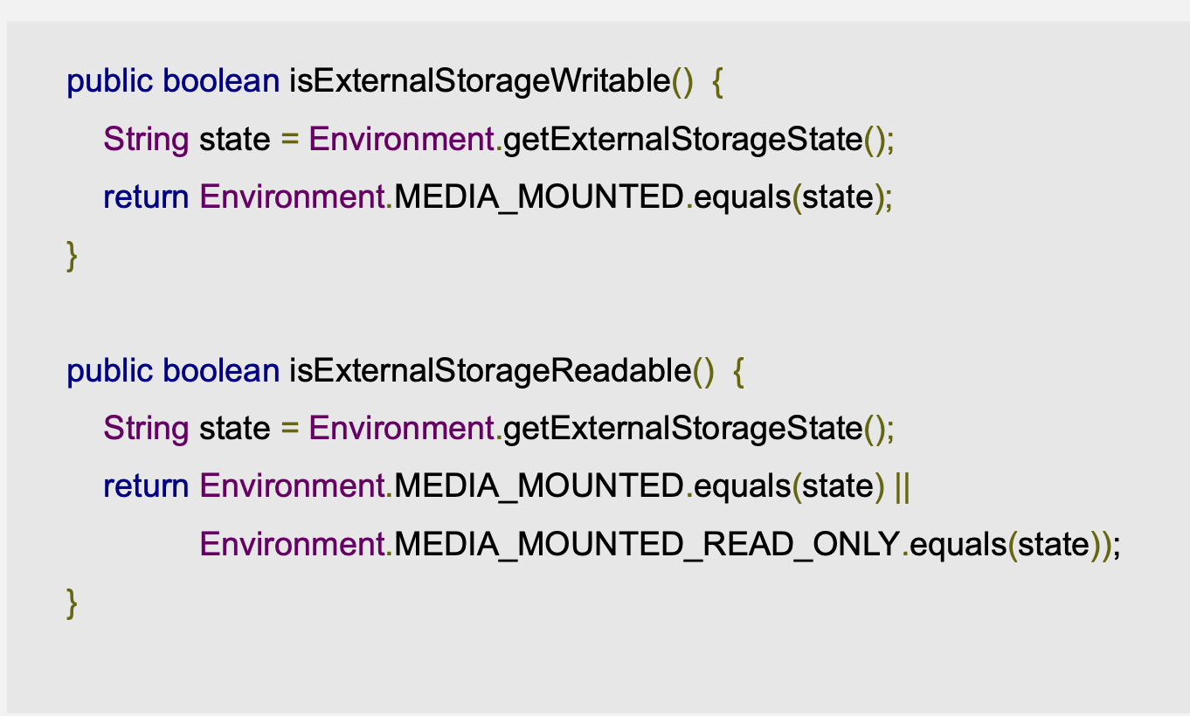
External storage

Slide 21
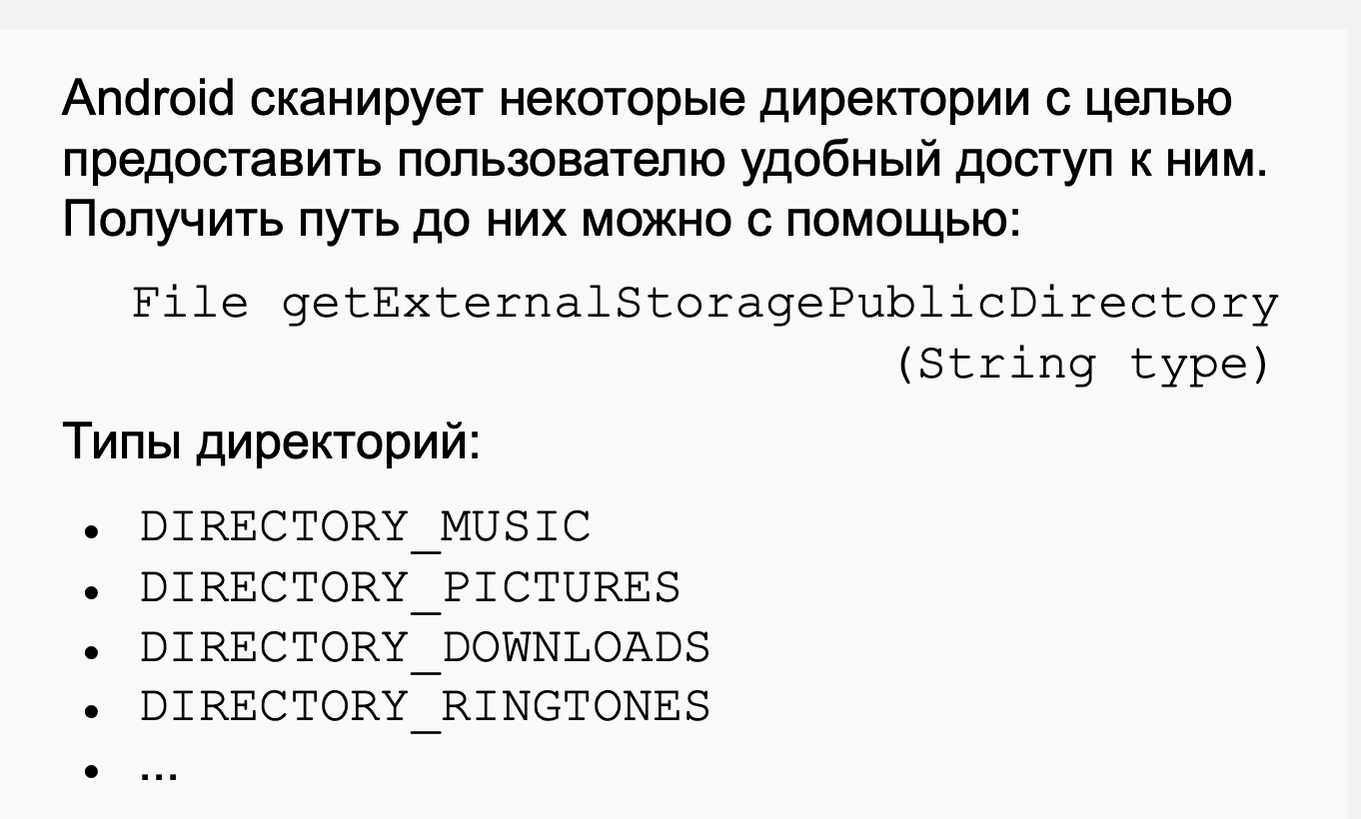
“Общедоступные” директорие

Slide 22
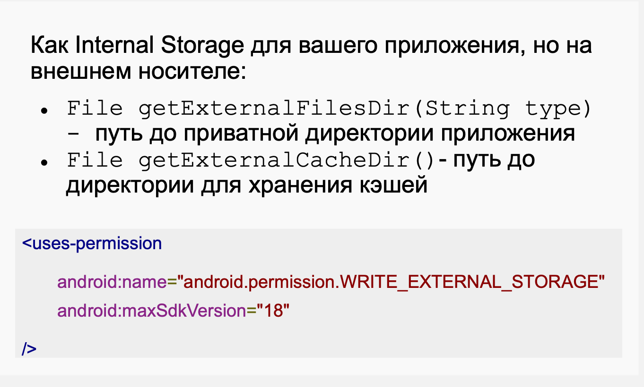
Приватные внешние директории

Slide 23
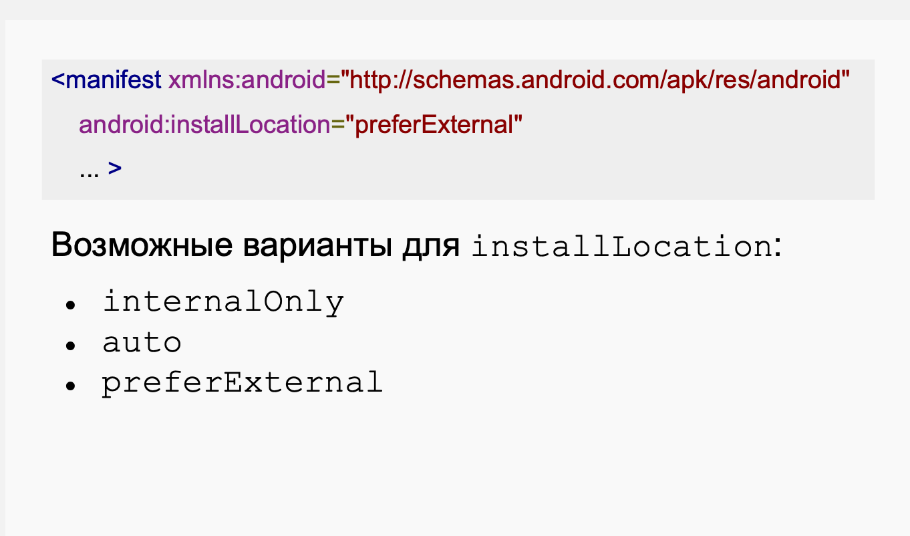
Куда останавливается приложение

Slide 24
База данных

Slide 25
Room - Entity
@Entity(tableName = "word_table") public class Word { @PrimaryKey @NonNull @ColumnInfo(name = "word") private String mWord; public Word(@NonNull String word) { this.mWord = word; } public String getWord() { return this.mWord; } }

Slide 26
Room - DAO
@Dao public interface WordDao { // allowing the insert of the same word multiple times by passing a // conflict resolution strategy @Insert(onConflict = OnConflictStrategy.IGNORE) void insert(Word word); @Query("DELETE FROM word_table") void deleteAll(); @Query("SELECT * FROM word_table ORDER BY word ASC") List<Word> getAlphabetizedWords(); }

Slide 27
Попробуем практику

